Slide 1



AWS Serverless data lake jumpstart

Slide 2
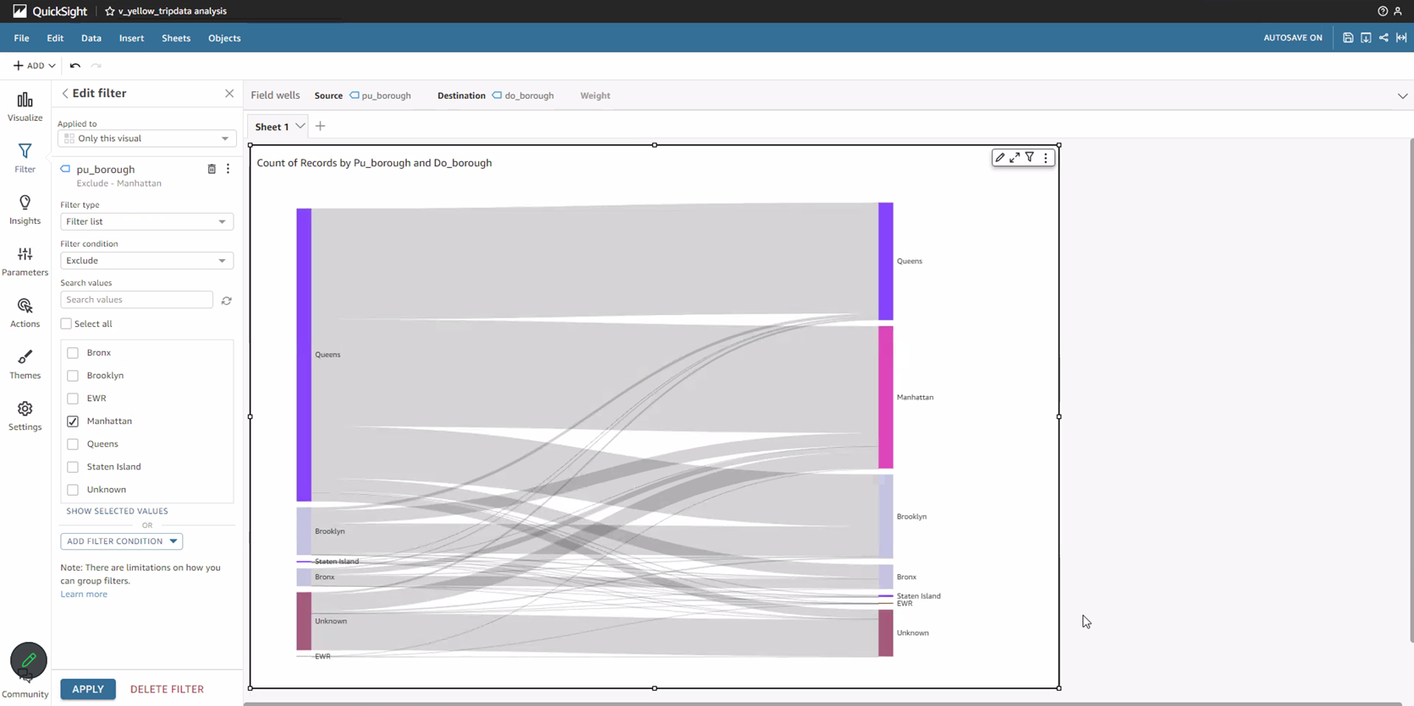
SCOPE OF THE BUSINESS
This project is to analyze how business functions within a particular business entity by reviewing Demand prediction, Route optimization, Pricing strategies, Customer segmentation, Demography

Slide 3

Introduction TO DATA-LAKE
We will explore the fundamental concepts behind a serverless data lake and its advantages over the traditional data warehousing approaches, we will delve into the core AWS services such as AWS Glue for ETL and data catalog management, Amazon S3 for data lake storage, Amazon Athena to query data and Amazon Quick-Sight to visualize data.

Slide 4
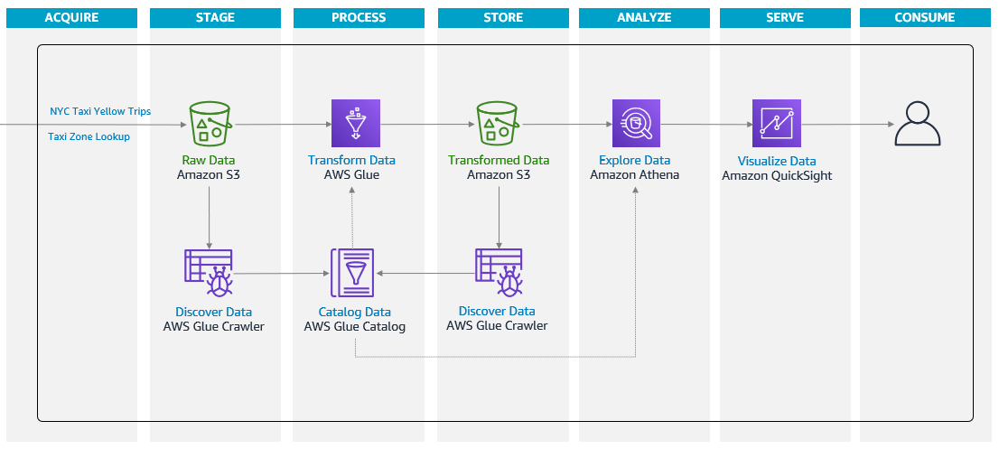
Our Goal
The objective of our project is to enable us to jumpstart our journey of building a serverless data lake using the Lambda Architecture data-processing design pattern. We will be going through a series of guided hands-on lab exercise using AWS serverless services to build a solution and tackle real-world scenarios.

Slide 5
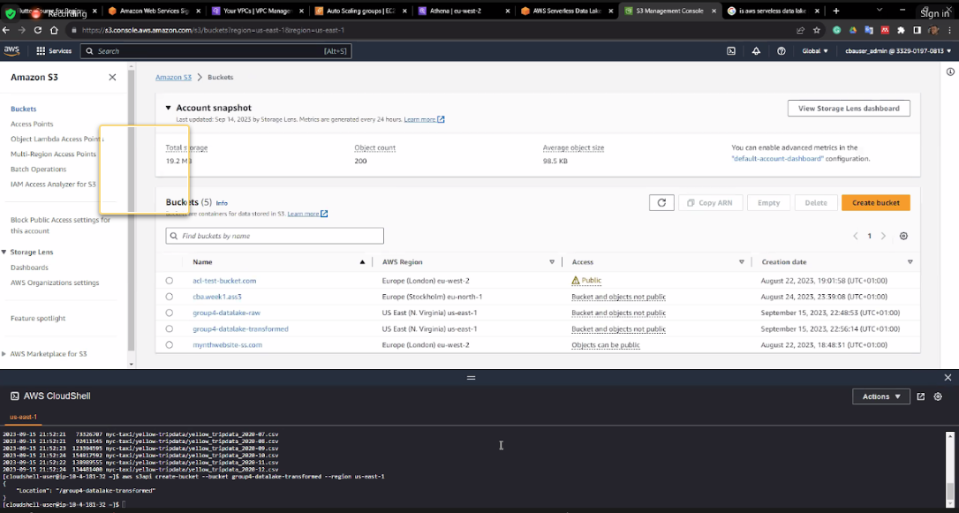
Getting started
Creation of account
Selection of N. Virginia (us-east-1)
Creating the s3 bucket using the cloud shell terminal
Creating the IAM service role for AWS Glue

Slide 6
AWS Glue / CRAWLER
WHY
We are using AWS glue to fully managed, extract, transform and load (ETL) which are used to automatically discover and catalog the data in various sources such as database, data lakes and data warehousing
It is cost effective
USES
Data catalog creation
Data discovery and cataloging
Schema evolution
Automatic partitioning
Integration with other AWS services
Notes:
Aws glue crawlers automate the process of discovering, cataloging and tracking changes in your data sources. They provide a foundation for building data pipelines, ETL processes and analyse workflows. Making it easier to wok with diverse and evolving datasets in the AWS ecosystem.

Slide 7
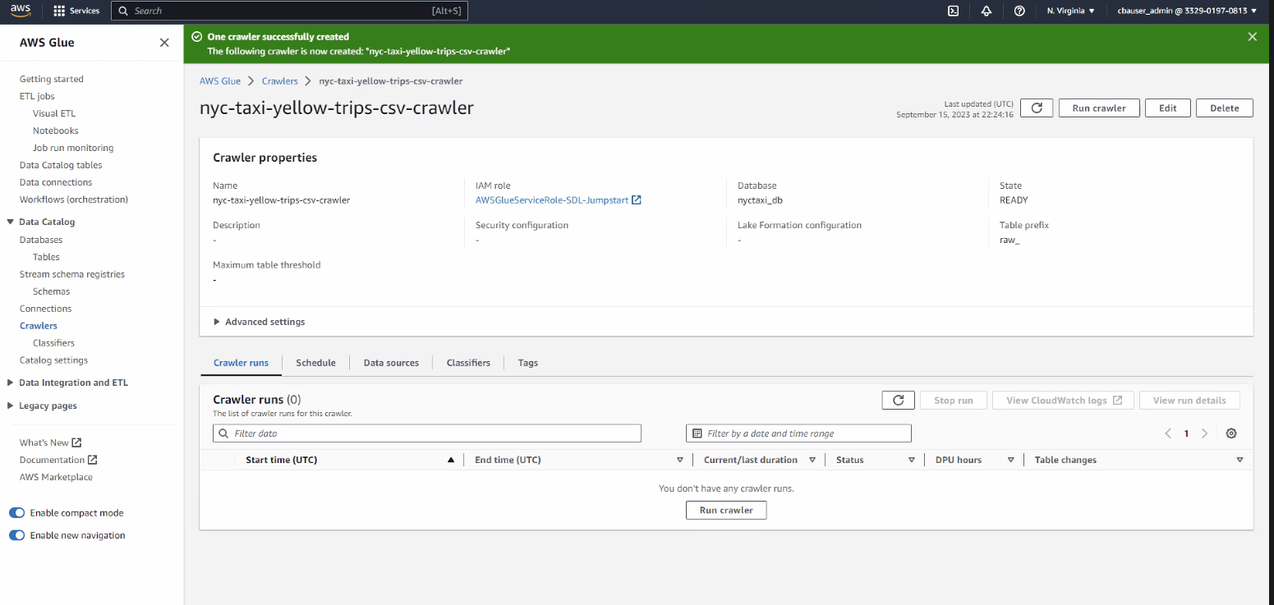
AWS Glue / CRAWLER

Slide 8

Amazon Athena
WHY
We use Athena to analyze our data stored in the S3 bucket using the SQL queries
It is cost effective i.e we do not have to pay for the maintenance, patching, scaling instead we only pay for the queries run on the SQL
High performance and scalability i.e it enables high performance query execution
USES
Data lake analytics
Ad hoc querying
Log analysis
Run SQL queries to explore the data
Notes:
Data lake analytics – perform queries on the data lake to extract the information needed for the project without having to transform or load data into a separate system
Ad hoc querying -
Log analysis

Slide 9
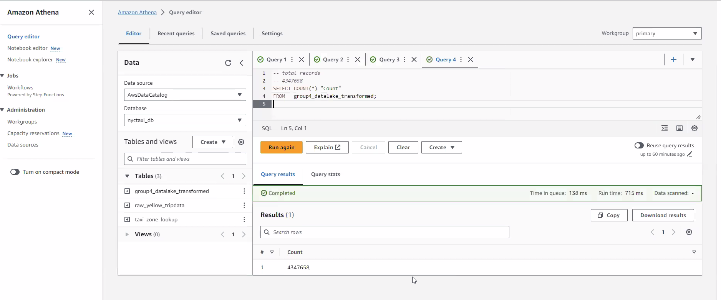
Amazon Athena

Slide 10
Transforming Data
Create a job using Glue Studio
Add a data source
Remove records with NULL values
Filter records
Add another data source
Join data
Add and join another dataset
Transform data and save to target
Run the job

Slide 11
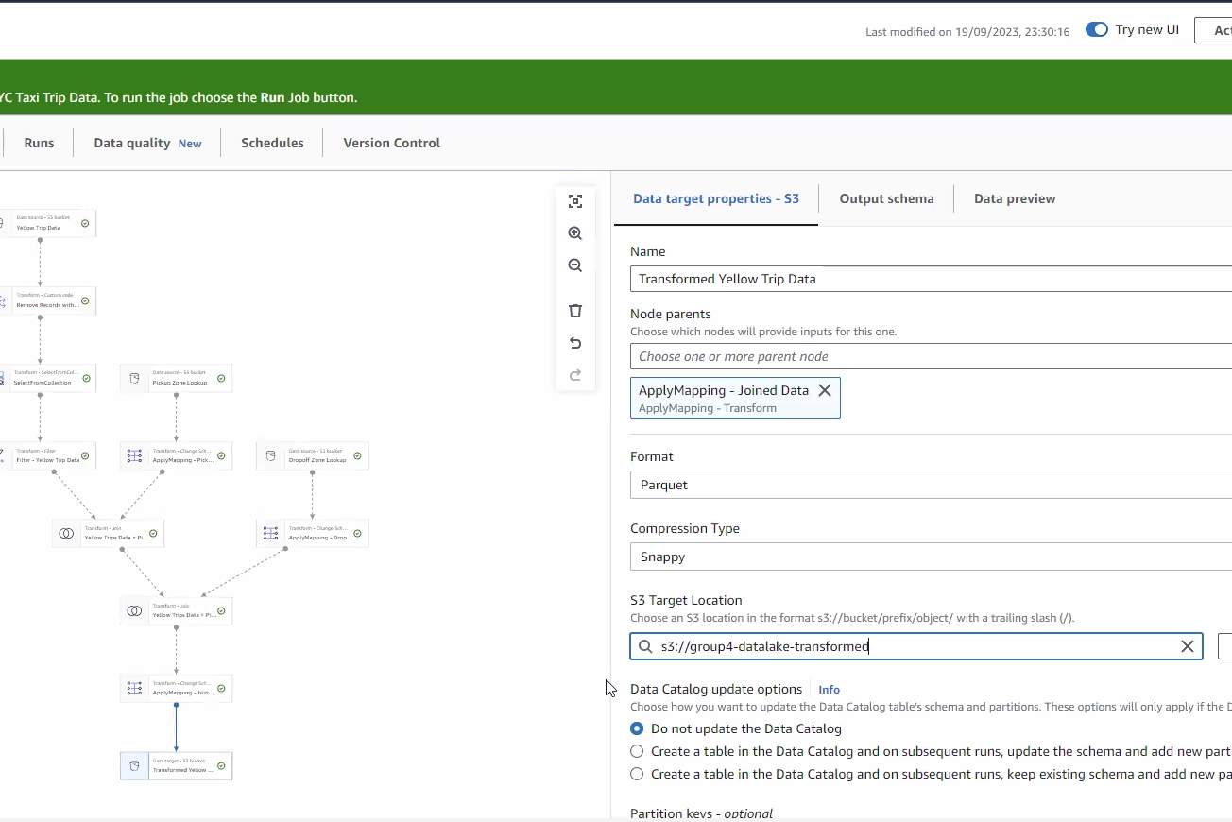
Transforming Data

Slide 12
Enriching Data
Catalog
Catalog transformed data
Validate
Validate transformed data
Enrich
Enrich transformed data

Slide 13
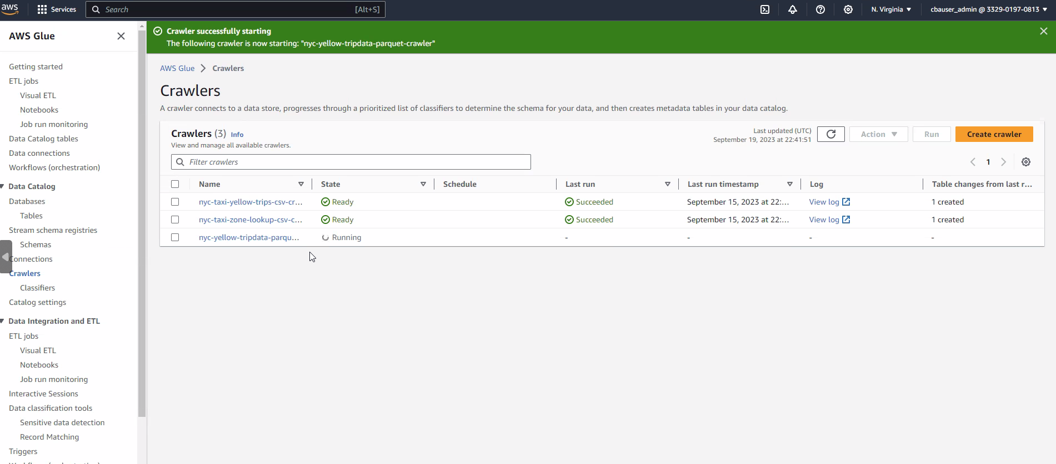
Enriching Data

Slide 14
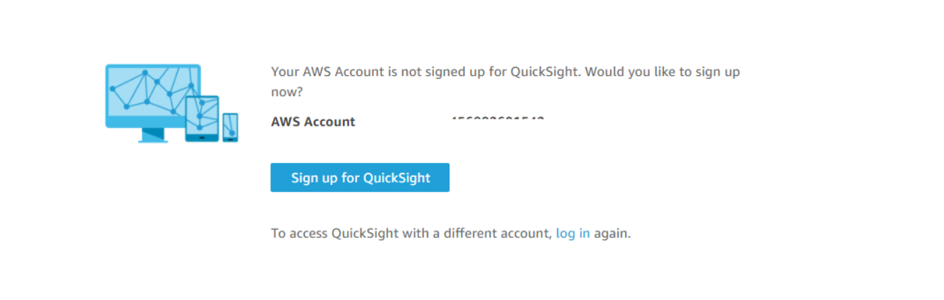
Visualizing THE Data / QUICKSIGHT
Notes:
What is quicksight?
is a scalable, serverless, embeddable, machine learning-powered business intelligence (BI) service built for the cloud. QuickSight lets you easily create and publish interactive BI dashboards that include Machine Learning-powered insights. QuickSight dashboards can be accessed from any device, and seamlessly embedded into your applications, portals, and websites.
WHY ENTERPRISE ?
Access data in private VPCs
Row-level security for dashboards
secure data encrypted at rest
connect to your active directory
use active directory groups
send email reports
we select the US East (N. Virgin)
Notification email address – [your email address]
we make sure we choose S3 buckets while creating the account
we also make sure we enable the amazon antenna in order to have access to our transformed date in s3 bucket
we connect our data set after successfully created the QuickSight by selecting Athena
we Import to SPICE for quicker analytics
SPICE stands for Super-fast, Parallel, In-memory Calculation Engine
we had issues in visualizing our data and we figured we had to buy more STORAGE on SPICE for us to be able to successfully visualize our data on QuickSight
After the importation of our data was completed
we use SANKEY to visualize our data
then we run different regions for pick up and drop off to observe the traffic flow patterns using same SANKEY visual type

Slide 15
Visualizing THE Data
Using Amazon QuickSight
Connect to a data source
Review dataset
Visualize data
Notes:
What is quicksight?
is a scalable, serverless, embeddable, machine learning-powered business intelligence (BI) service built for the cloud. QuickSight lets you easily create and publish interactive BI dashboards that include Machine Learning-powered insights. QuickSight dashboards can be accessed from any device, and seamlessly embedded into your applications, portals, and websites.
WHY ENTERPRISE ?
Access data in private VPCs
Row-level security for dashboards
secure data encrypted at rest
connect to your active directory
use active directory groups
send email reports
we select the US East (N. Virgin)
Notification email address – [your email address]
we make sure we choose S3 buckets while creating the account
we also make sure we enable the amazon antenna in order to have access to our transformed date in s3 bucket
we connect our data set after successfully created the QuickSight by selecting Athena
we Import to SPICE for quicker analytics
SPICE stands for Super-fast, Parallel, In-memory Calculation Engine
we had issues in visualizing our data and we figured we had to buy more STORAGE on SPICE for us to be able to successfully visualize our data on QuickSight
After the importation of our data was completed
we use SANKEY to visualize our data
why Sankey? for easy data flow, we all know that AWS is a comolex system that involves the movement of data between
various components such as storage,processing and analytics services, sankey diagrams can visually represent the flow
of data through these components, making it easier to understand the data pipeline and identify potential bottlenecks or inefficiencies.
for our project we used sankey to visualize, cost analysis, workflow and resource allocation by showing the PU and DO per trip also to visualize the most common mode of payment either by cash or credit card
then we run different regions for pick up and drop off to observe the traffic flow patterns using same SANKEY visual type

Slide 16
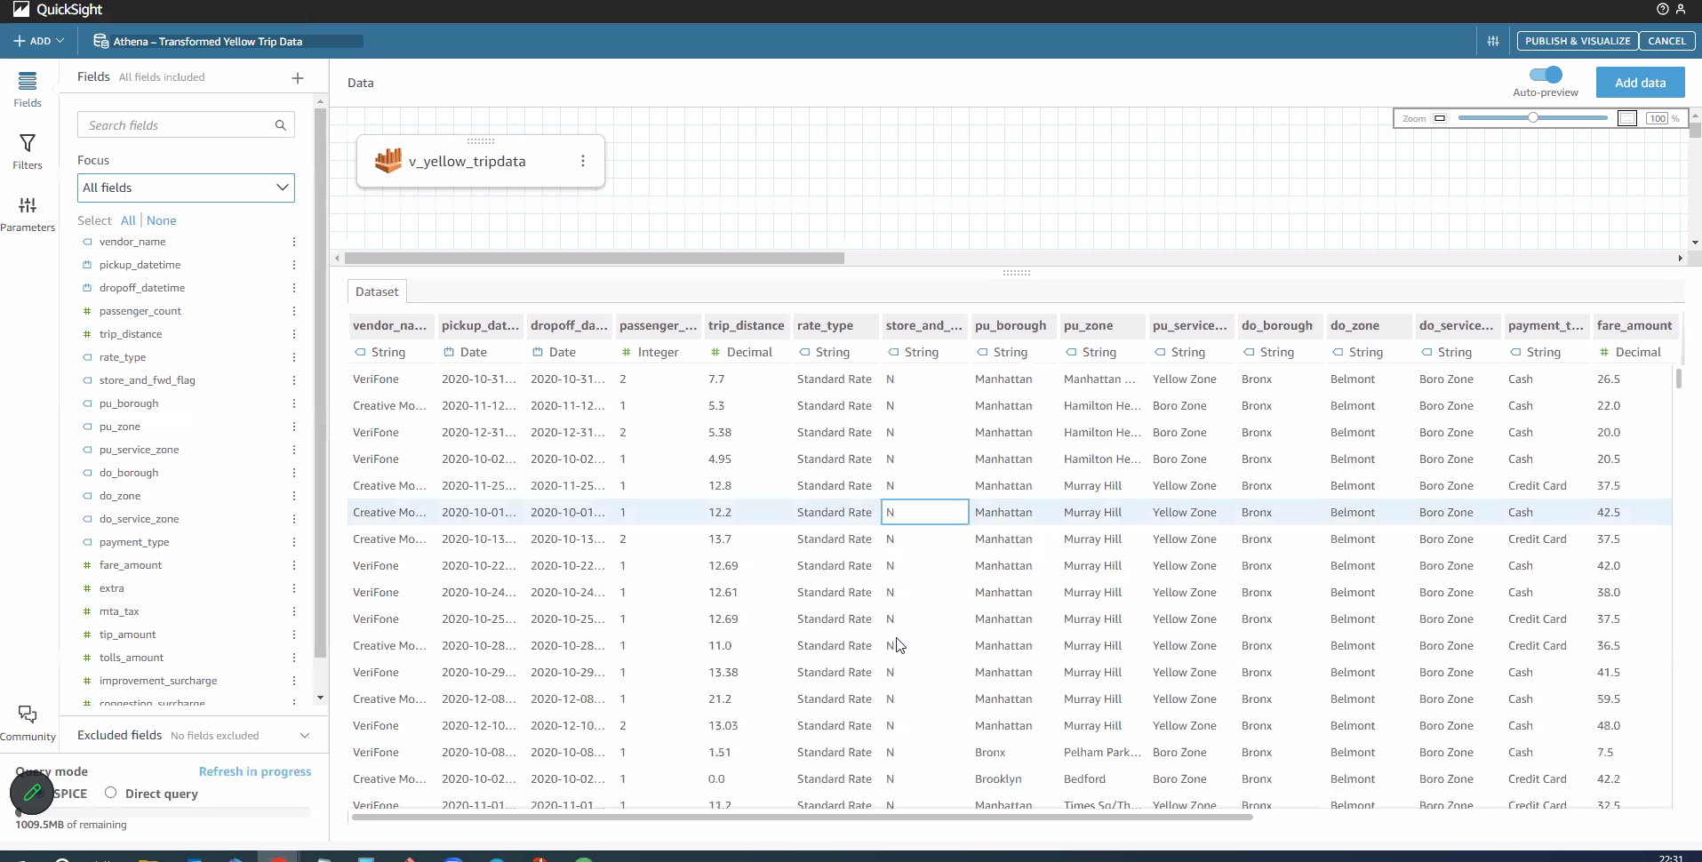
Visualizing THE Data
Notes:
What is quicksight?
is a scalable, serverless, embeddable, machine learning-powered business intelligence (BI) service built for the cloud. QuickSight lets you easily create and publish interactive BI dashboards that include Machine Learning-powered insights. QuickSight dashboards can be accessed from any device, and seamlessly embedded into your applications, portals, and websites.
WHY ENTERPRISE ?
Access data in private VPCs
Row-level security for dashboards
secure data encrypted at rest
connect to your active directory
use active directory groups
send email reports
we select the US East (N. Virgin)
Notification email address – [your email address]
we make sure we choose S3 buckets while creating the account
we also make sure we enable the amazon antenna in order to have access to our transformed date in s3 bucket
we connect our data set after successfully created the QuickSight by selecting Athena
we Import to SPICE for quicker analytics
SPICE stands for Super-fast, Parallel, In-memory Calculation Engine
we had issues in visualizing our data and we figured we had to buy more STORAGE on SPICE for us to be able to successfully visualize our data on QuickSight
After the importation of our data was completed
we use SANKEY to visualize our data
why Sankey? for easy data flow, we all know that AWS is a comolex system that involves the movement of data between
various components such as storage,processing and analytics services, sankey diagrams can visually represent the flow
of data through these components, making it easier to understand the data pipeline and identify potential bottlenecks or inefficiencies.
for our project we used sankey to visualize, cost analysis, workflow and resource allocation by showing the PU and DO per trip also to visualize the most common mode of payment either by cash or credit card
then we run different regions for pick up and drop off to observe the traffic flow patterns using same SANKEY visual type

Slide 17

Visualizing THE Data
Notes:
What is quicksight?
is a scalable, serverless, embeddable, machine learning-powered business intelligence (BI) service built for the cloud. QuickSight lets you easily create and publish interactive BI dashboards that include Machine Learning-powered insights. QuickSight dashboards can be accessed from any device, and seamlessly embedded into your applications, portals, and websites.
WHY ENTERPRISE ?
Access data in private VPCs
Row-level security for dashboards
secure data encrypted at rest
connect to your active directory
use active directory groups
send email reports
we select the US East (N. Virgin)
Notification email address – [your email address]
we make sure we choose S3 buckets while creating the account
we also make sure we enable the amazon antenna in order to have access to our transformed date in s3 bucket
we connect our data set after successfully created the QuickSight by selecting Athena
we Import to SPICE for quicker analytics
SPICE stands for Super-fast, Parallel, In-memory Calculation Engine
we had issues in visualizing our data and we figured we had to buy more STORAGE on SPICE for us to be able to successfully visualize our data on QuickSight
After the importation of our data was completed
we use SANKEY to visualize our data
why Sankey? for easy data flow, we all know that AWS is a comolex system that involves the movement of data between
various components such as storage,processing and analytics services, sankey diagrams can visually represent the flow
of data through these components, making it easier to understand the data pipeline and identify potential bottlenecks or inefficiencies.
for our project we used sankey to visualize, cost analysis, workflow and resource allocation by showing the PU and DO per trip also to visualize the most common mode of payment either by cash or credit card
then we run different regions for pick up and drop off to observe the traffic flow patterns using same SANKEY visual type

Slide 18

ANY QUESTIONS?
Notes:
What is quicksight?
is a scalable, serverless, embeddable, machine learning-powered business intelligence (BI) service built for the cloud. QuickSight lets you easily create and publish interactive BI dashboards that include Machine Learning-powered insights. QuickSight dashboards can be accessed from any device, and seamlessly embedded into your applications, portals, and websites.
WHY ENTERPRISE ?
Access data in private VPCs
Row-level security for dashboards
secure data encrypted at rest
connect to your active directory
use active directory groups
send email reports
we select the US East (N. Virgin)
Notification email address – [your email address]
we make sure we choose S3 buckets while creating the account
we also make sure we enable the amazon antenna in order to have access to our transformed date in s3 bucket
we connect our data set after successfully created the QuickSight by selecting Athena
we Import to SPICE for quicker analytics
SPICE stands for Super-fast, Parallel, In-memory Calculation Engine
we had issues in visualizing our data and we figured we had to buy more STORAGE on SPICE for us to be able to successfully visualize our data on QuickSight
After the importation of our data was completed
we use SANKEY to visualize our data
then we run different regions for pick up and drop off to observe the traffic flow patterns using same SANKEY visual type

